Slide 1


St Peter’s CofE Primary School
Foundation Stage
Welcome

Slide 2

Our Vision
Our school vision of all our children excelling has been chosen by all in our community. Through shared working we have identified, that our children should not only have access to an 'Outstanding' broad and balanced curriculum but interwoven are the teachings of God, Jesus and the bible. Through collaboration with our parents, staff, governors and children, we have identified what we wish for our futures.
At St. Peter’s, we have a rich curriculum, that is rooted in a wholesome Christian ethos, that inspires and motivates children to achieve their individual successes that will prepare them for a love of life-long learning
This is distilled into our shortened version of,
‘One Family, Aiming High, Learning Together with God’

Slide 3
Early Years Foundation Stage at
St Peter’s School
At St Peter’s we want your children to be confident and happy learners, who are resourceful, curious and keen.
We endeavour to foster positive attitudes to learning and high levels of engagement.
How do children learn best?
Playing and exploring
Being active and motivated
Thinking and being creative

Slide 4
Early Years Curriculum
Play is essential for children’s learning and development.
We scaffold and support the children’s learning through their interests and curiosity.
Children will also spend time on guided activities with their teachers.
Our Curriculum is……
Balanced and inspiring
Hands on and child led
Play based
Challenging and purposeful
We achieve this through…..
Planning in the moment
High quality resources
Half termly topics
Teacher led carpet sessions

Slide 5
Curriculum
Informs our planning so we can provide the best and most enriching provision for your child.
Clear progression in skills needed across all areas of development.
Prime Areas: Physical Development; Personal, Social & Emotional Development; Communication & Language Development
Specific Areas: Mathematics; Literacy; Expressive Arts & Design and Understanding the World
Ensures all children are catered for appropriately regardless of their starting point.
We have the highest expectations for the progress and development of all children.

Slide 6

Tapestry
An online learning journal.
Download the Tapestry App on your phone or tablet.
Observations, photos and videos of your child’s achievements and learning are uploaded by the class teacher.
Instant feedback on your child’s learning.
Upload and share news, achievements or ‘wow’ moments from home – we love to hear from you!
A really useful tool to foster positive relationships and home/school links.

Slide 7
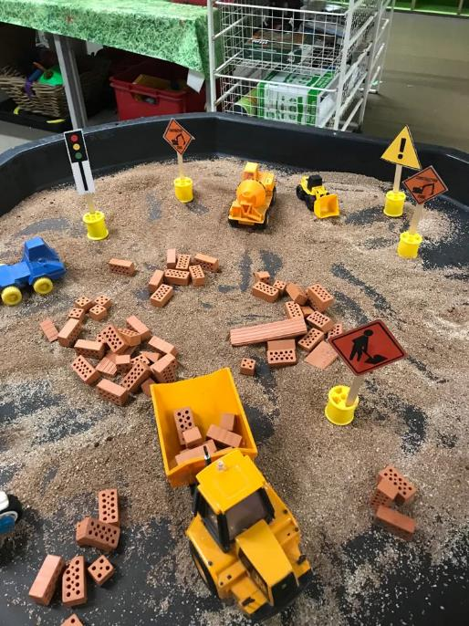
Home School Partnership
We strive to build strong relationships with parents and carers.
Clear communication is vital.
Weekly curriculum updates.
Termly Newsletters.
Information and support leaflets.
Parent’s Evenings
Meet the teacher event
Stay and Play sessions
Positive home/school links impact positively on the progress of the children.

Slide 8
Thank you
Look on our website for further information under individual year groups.
Any further questions please email us at:
admin@spmillend.herts.sch.uk

